Slide 1


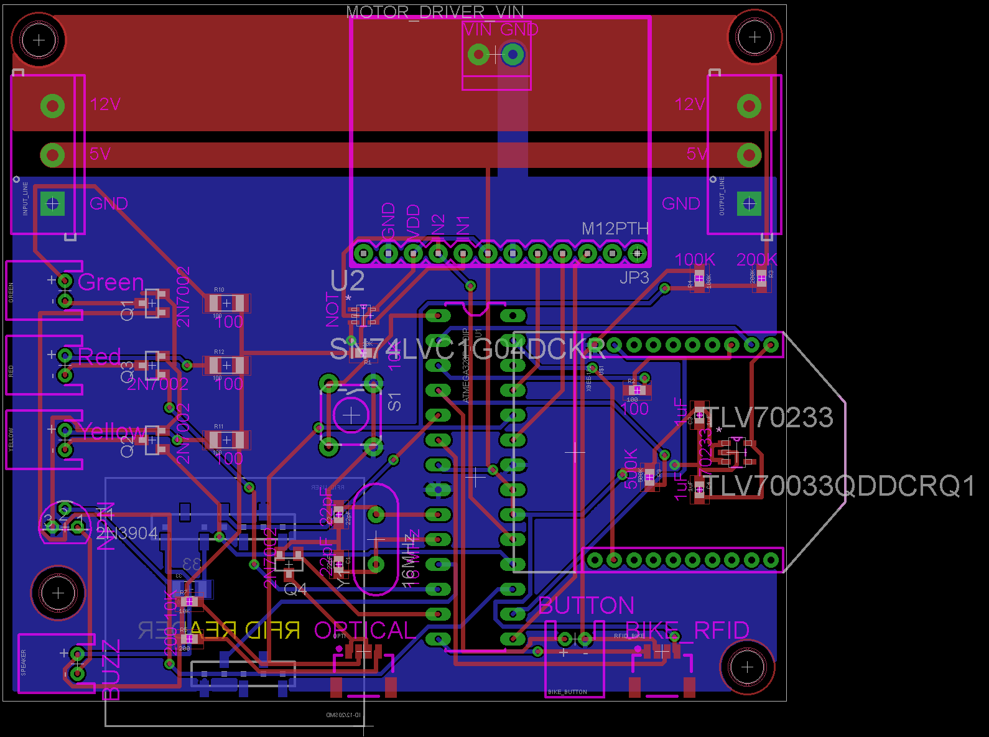
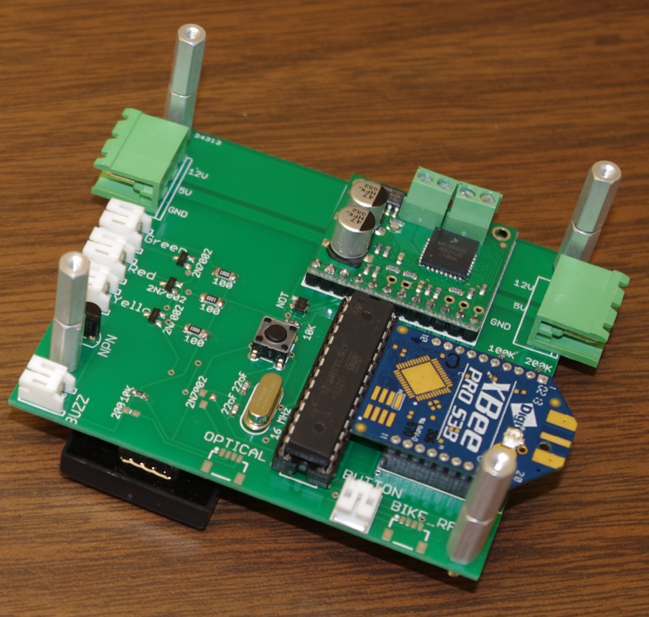
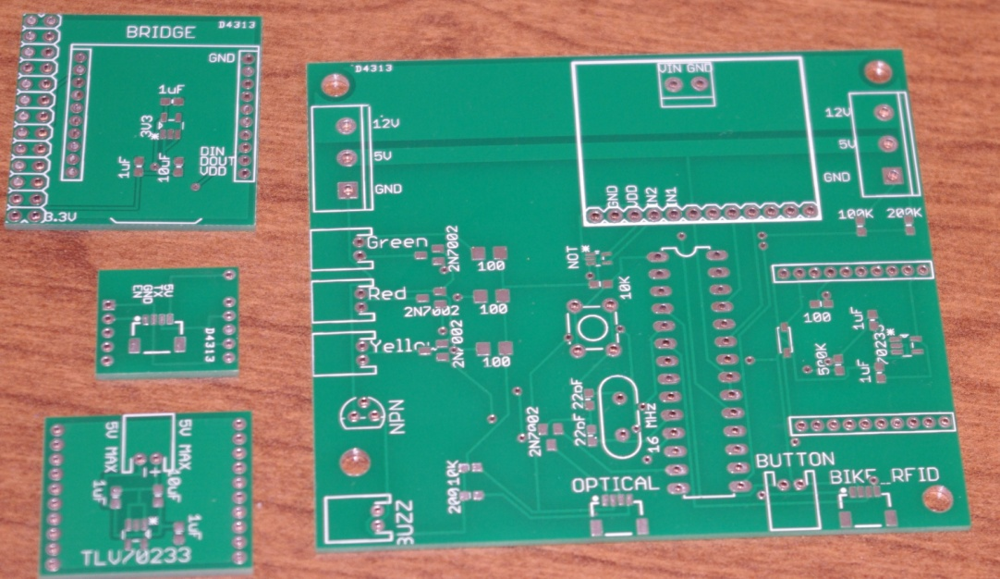
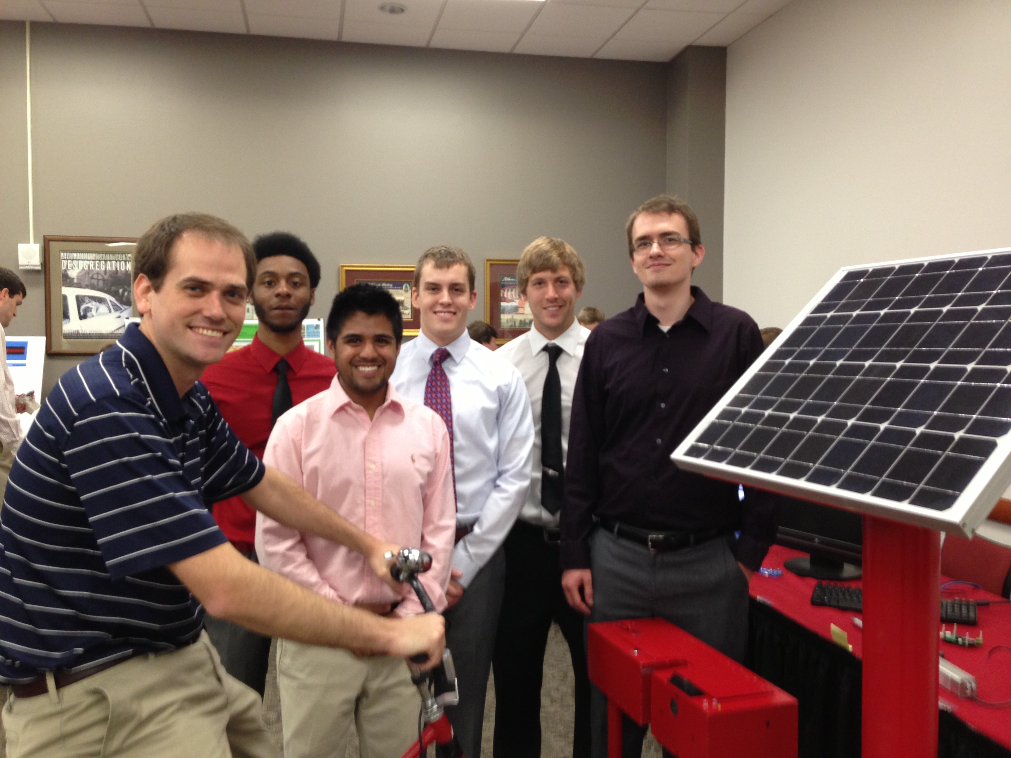
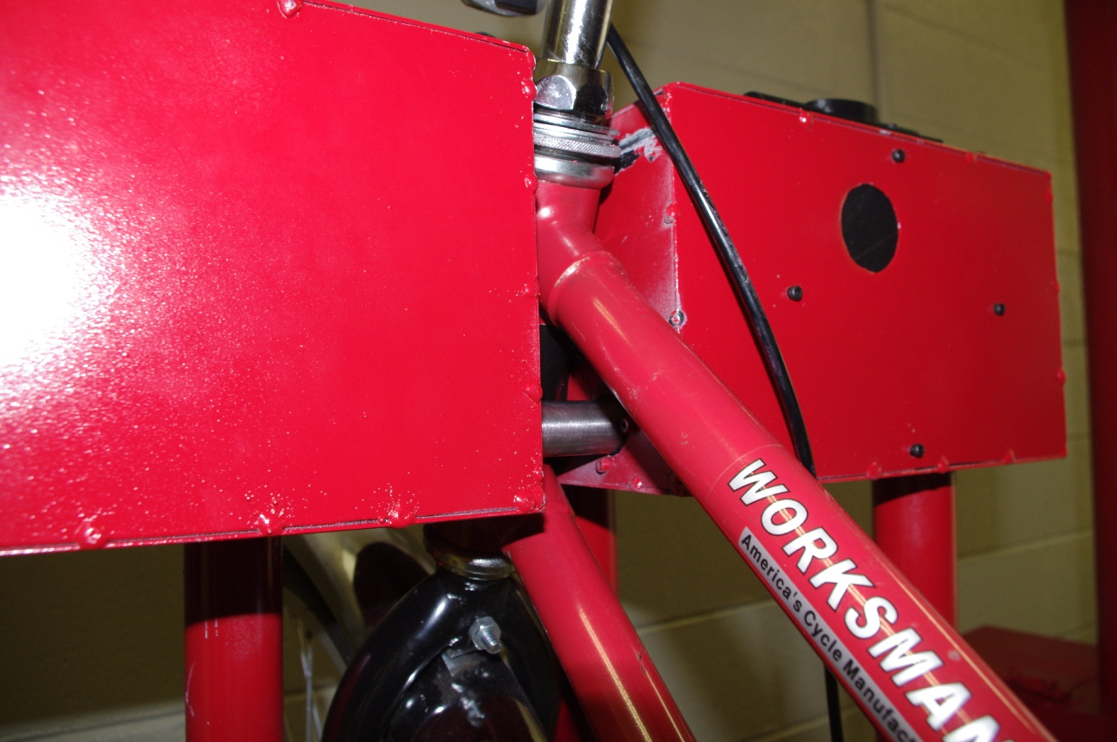
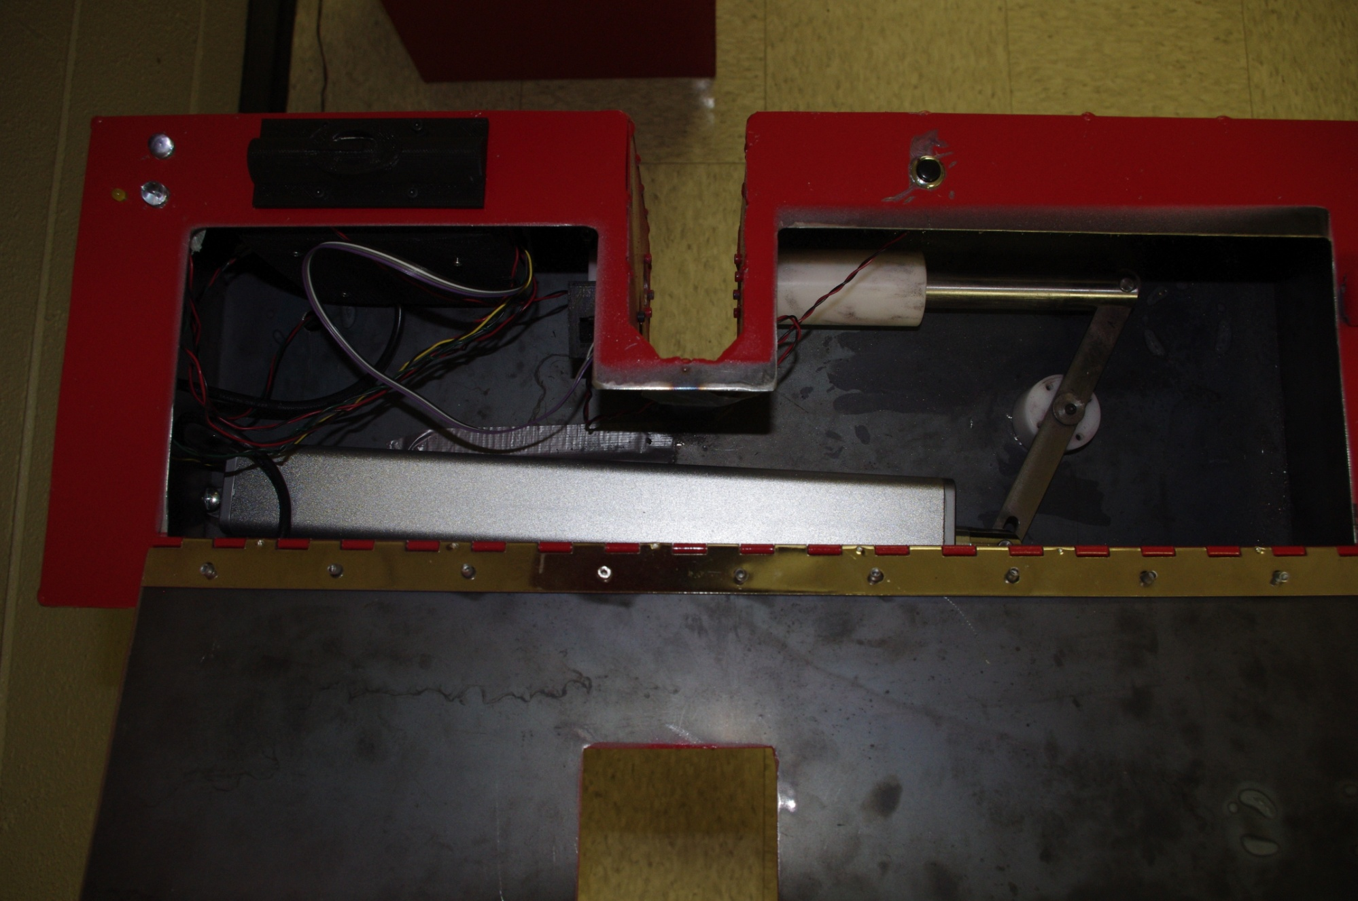
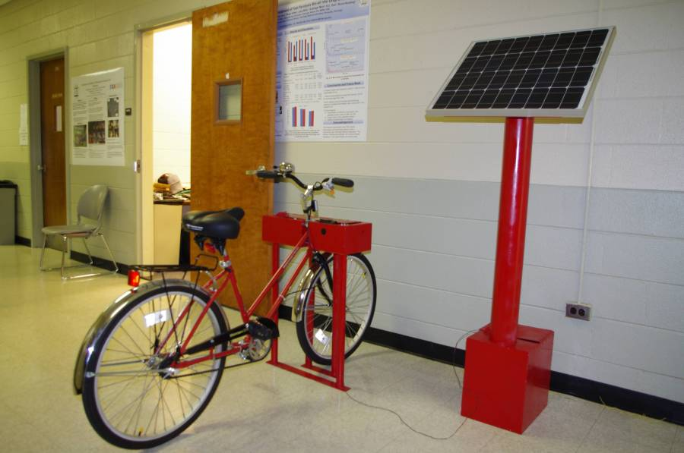
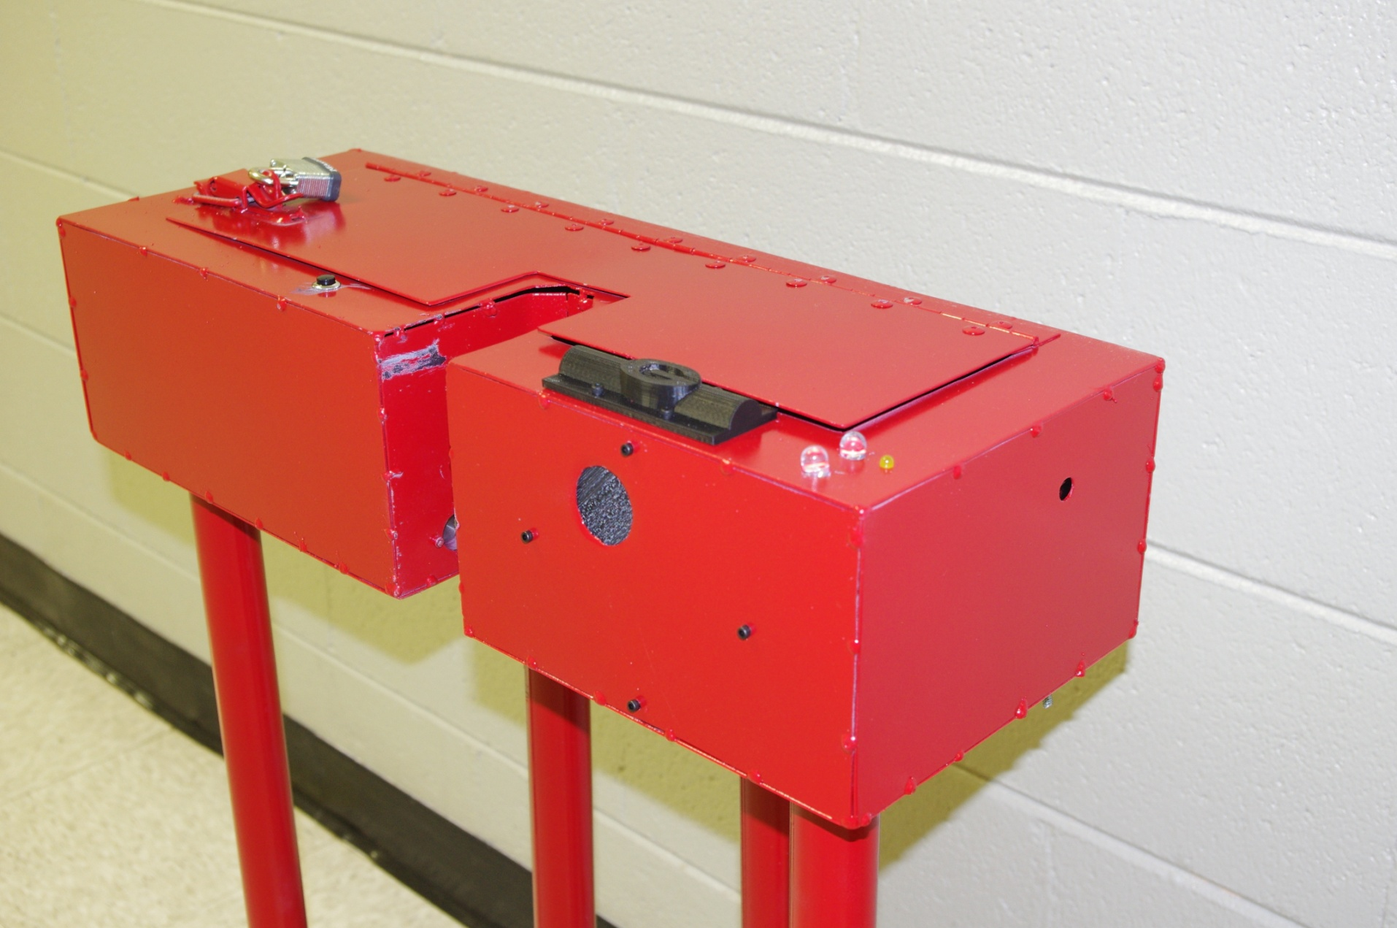
Automated Bike Share Project
Team: Oscar Garduno, Nathan Kelley, Eric Refour, Colby Sweet, Nathaniel Wood
Mentors: Dr. Kyle Johnsen, Dr. Peter Kner
Driftmier Engineering Center, Athens, GA 30602
Problem Statement
Design Overview
Conclusion & Future Work
We are trying to provide an alternative method of transportation for UGA students, faculty, and staff on campus. Our bike sharing system will provide an easy automated checkout system that is accessible campus wide. The current bike sharing system on campus is virtually non-existent due to it being exclusive to certain departments. With the current system, users can only return bikes to the department from which it was checked out. Bicycles in the current system are only accessible during operating hours of each participating department. A complete bike sharing system would provide access to all students and faculty, 24 hours a day. Users would be able to checkout a bike from one station on campus and return it to either the same station or any other station on campus.
Computer Engineering Design:
The bike station electronics were designed to provide ease of use for the users . The electronics allow for the stations to be placed in a variety of locations across campus. The stations are capable of talking to the server to keep track of checkout information and verify bike locks.
After research and testing, a working prototype of the station, dock, bridge, and database was successfully built. Each component of the system was able to communicate with each other in order to lock or unlock a bike, as long as there was a valid bike and valid user RFID. The project is completely scalable because more docks could be added to our station and more stations could be added to the network.
Future work would consist of better hardware and software security, corrections and improvements to the PCB design, and the hardware being used. The current security does not take into account the power being turned off, if the lid to access the PCB board is open or not, or if the online forms and websites are hacked.
The Team
Cost Analysis
Mechanical Engineering Design:
Mechanical design focused on ensuring that once the bike was locked, no one would be able to remove it. Simplicity was kept in mind to reduce the amount of parts needed; which also reduces the number of failure points. All parts were drawn and assembled using AutoCAD to ensure proper sizing. Strength calculations were performed to ensure the system met all the design needs.
From left to right: Kyle Johnsen, Eric Refour, Oscar Garduno,
Nathaniel Wood, Nathan Kelley, and Colby Sweet
Acknowledgements
This project was funded by the UGA Office of Sustainability.
1180 E Broad St Athens, GA 30602
(706) 542-1301
Also, special thanks to:
Kareem Mahmoud (customer) for bringing this project to the Engineering Center.
Thanks to Terry Walsh for manufacturing the final prototype.
Dr. Johnsen and Dr. Kner for their invaluable help.

